Slide 1


Command, Leadership, Ethics & Management
Group Presentations Assessment
Comdt D Earley
C & S School

Slide 2
Format
Group presentations: Pairs/ group of 3 allocated by lots.
When: Thursday, 18 SEP 2025
Duration: 20/30 min + Q & A
Marks: 180
Refs: TS 16/2022, p.18
CLEM Presentations Advance Sheet

Slide 3
Points for Consideration
Rehearse – DH and SRs available evenings and programmed SRT.
Define the question!
Answer the Question!
Agree/Disagree – IMPLICATIONS
Demonstrate research, knowledge of theory & analysis (Critical thinking is key)
Citations & References

Slide 4
Points for Consideration
Draw on:
Guest speakers Knowledge & Expertise – Dr D. Vincent, Cranfield University
Own military experience – but be aware of observer bias
Consider using appropriate/relevant case studies
Be aware of:
Referencing
Plagiarism (AI)

Slide 5
Points for Consideration
Structure makes it easier for the audience to follow
Consider as a starting point;
Problem Statement
BLUF/Executive Summary/Summary of findings
Framework
Content & Analysis
Conclusion (Restated BLUF)
Tell them what you are going to tell them, tell them, tell them what you told them
Consider BLUF as an anchor especially during transitions.
NB – This is not a checklist!

Slide 6
Points for Consideration
Academic Rigor
Sources – bibliography Legible
Correct tone
Don’t force IPD
Consider the rubric - Content, Analysis and Style
Presenting What? well to sell So What?

Slide 7
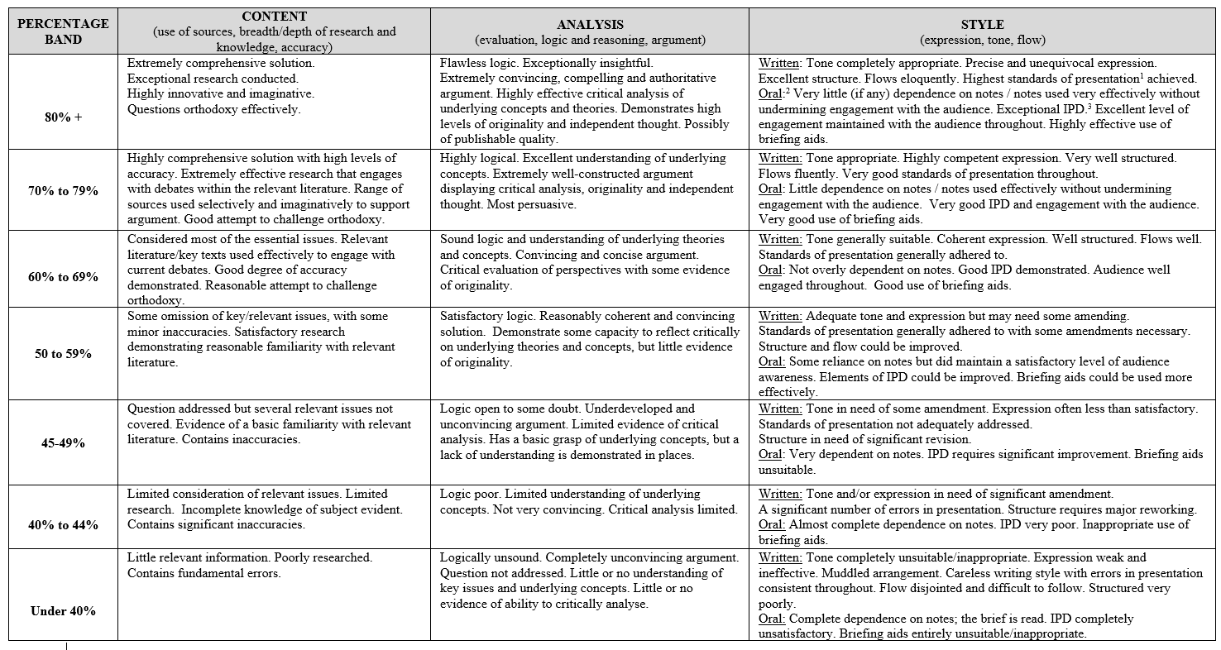

Slide 8
Submission Requirements
Before Presentations commence:
3 x PPS/Handout printout, stapled ONLY
3 slides to a page
Front and back
Black and white
This is NOT marked
After Presentations :
Digital version of PPT/Handout
References clearly legible
This is NOT marked

Slide 9
Feedback
Individual written feedback will be given when results are returned
Assessment will focus on the following areas:
Style: Eye contact, posture, ability of oral skills and coordination of the work in your team.
Content: Sequencing of material, overall framework used, introduction, use of relevant theory.
Quality of analysis: linkages to theory, literature, empirical and quantitative evidence, personal experience (where relevant).
Individual Content & Analysis: To include responses to Q&A
Time Management: Time penalties will be incurred for not finishing within the allocated time window (1 minute either side of the 20/30min mark).

Slide 10
Titles
As per Annex B of the advance sheet

Slide 11
Questions?

